Slide 1
Matrix Evolve Workshop
Rotopol 2025
Dharana Jayawardane
Technical Manager

Slide 2
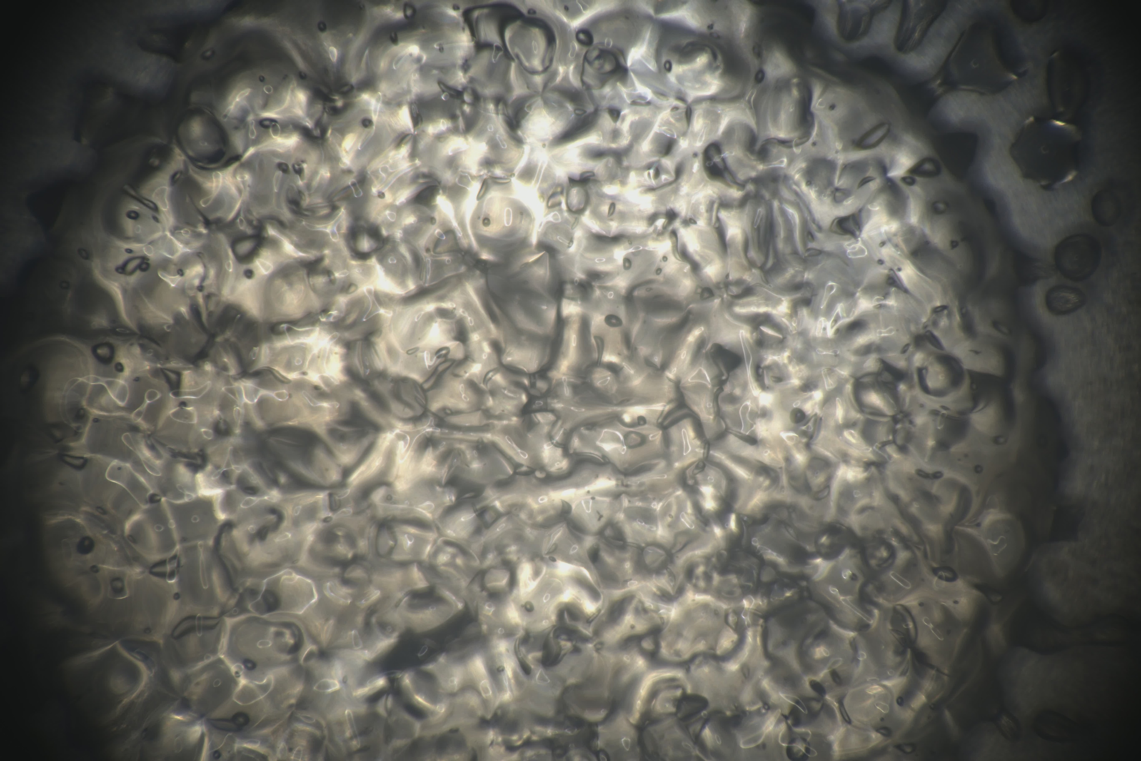
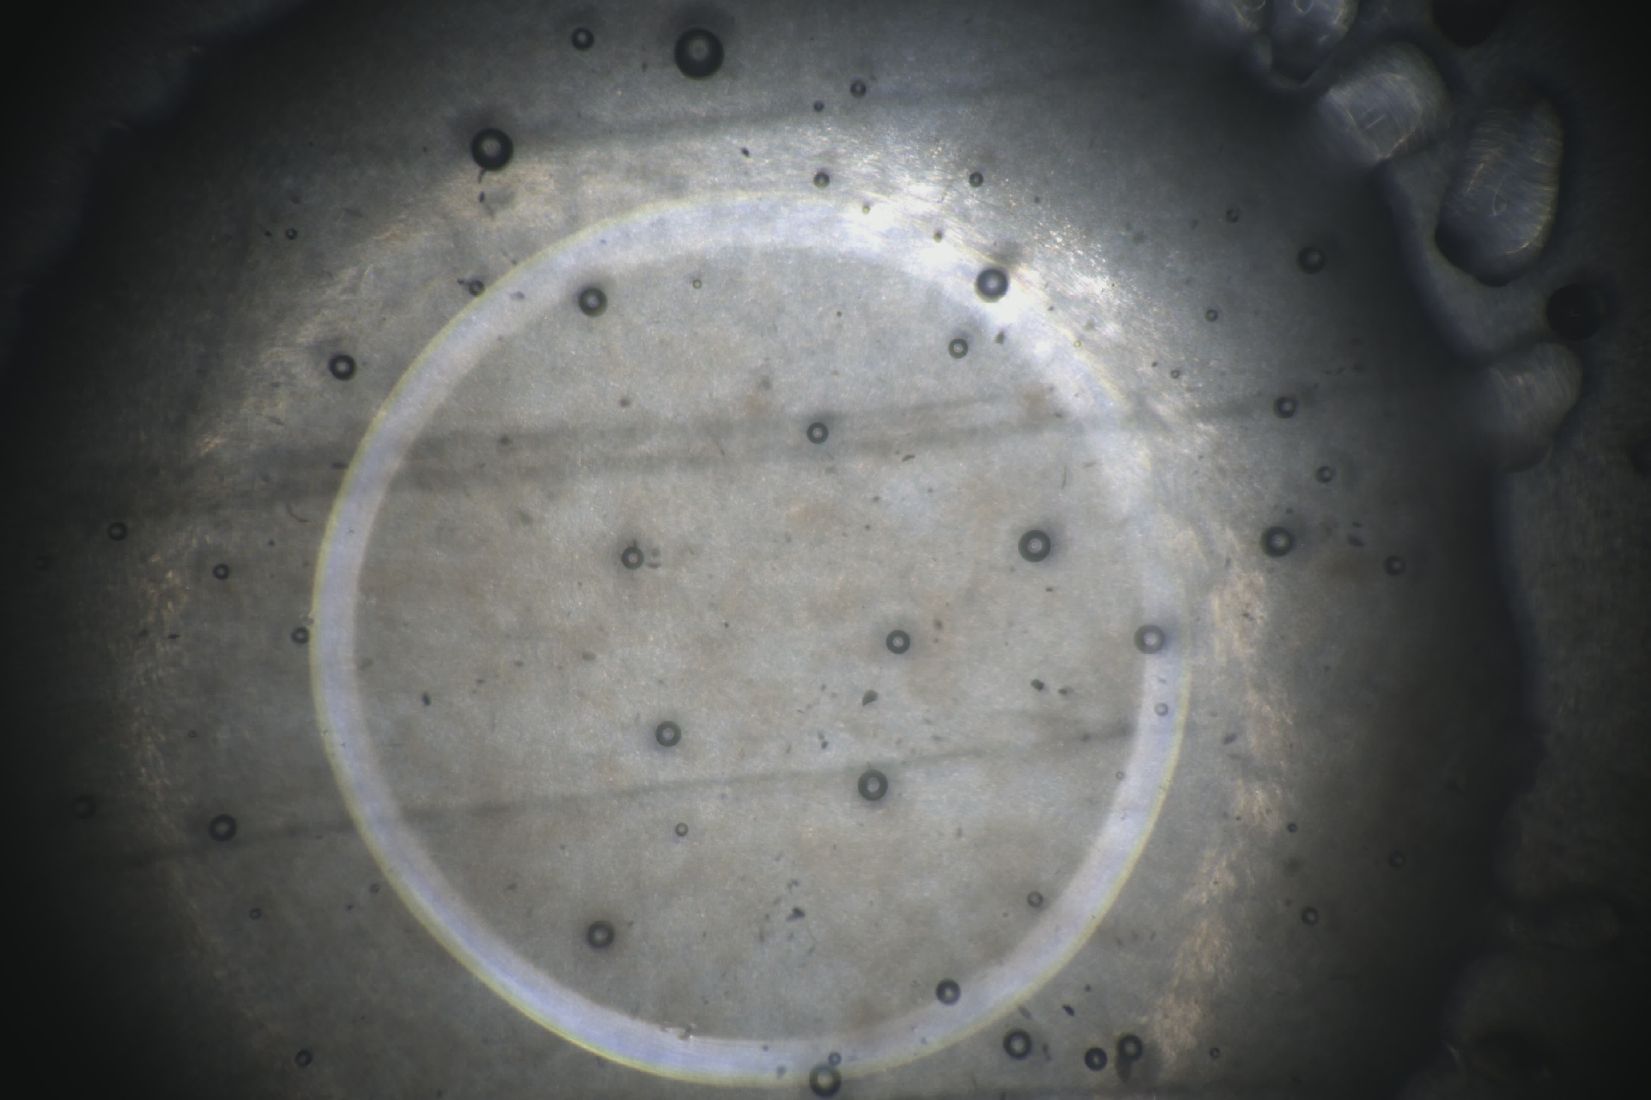
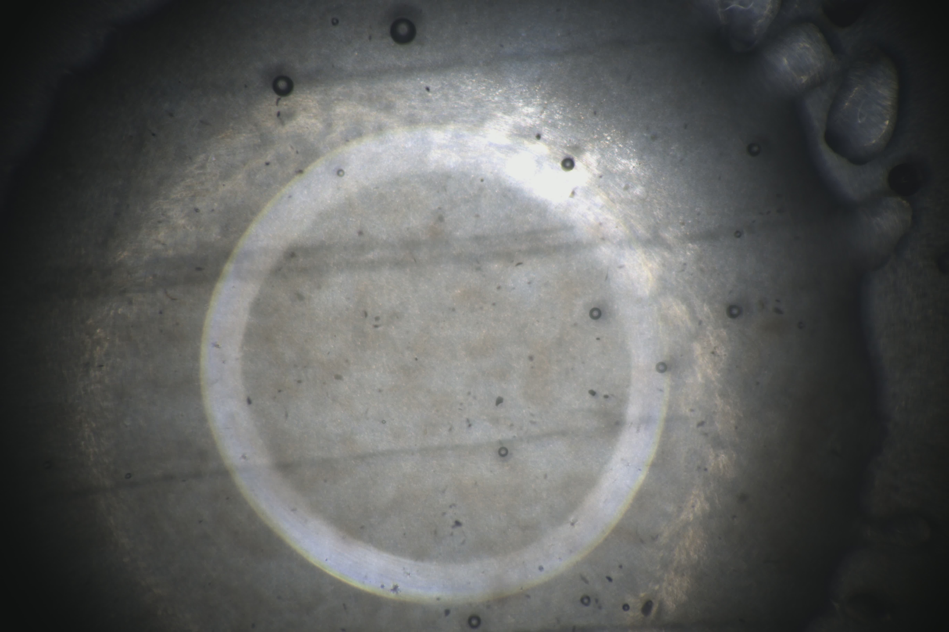
EVOLVE®
  Reducing surface tension between molten polymer particles
  Acts on the sintering phase of the process
  Does not influence the viscosity (MFI) of a polymer
  Leaves the final properties of material unchanged

Slide 3
EVOLVE® - Benefits
  10-20% reduction in overall cycle time
  potentially increase production output
  Energy savings by 10-20% reduction in gas consumption
  Lower CO₂ emission
  Reduction in the number of pinholes, leading to improved part quality

Slide 4
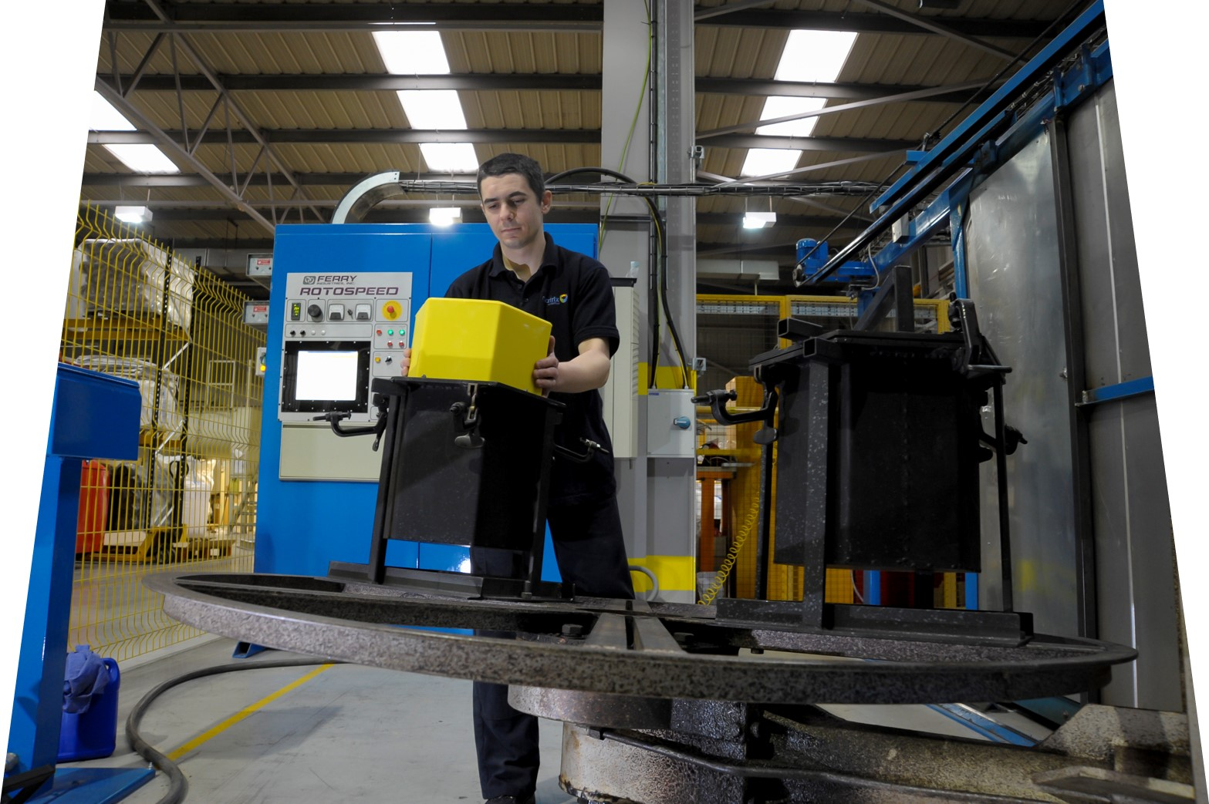
Experimental Study
  Revolve® N-307 (MFI 3.5 / 0.939 g/cm³)
  Hexagonal 18-liter bin
  Ferry RS1.90 gas-powered oven
  Fixed Oven Temperature
  Varied Oven Time
  Optimum Condition achieved by assessing:
  Part Density
  Impact Strength (ARM-I Standard)

Slide 5
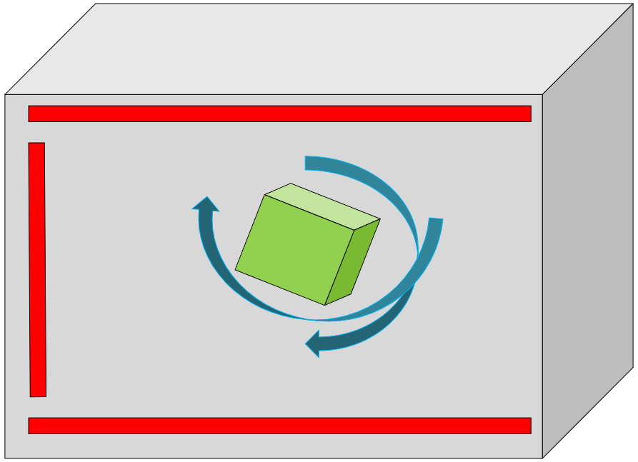
From Heat to Shape: The Journey of Polymer Transformation
Oven is heated up
Mould is taking in energy
Energy is transferred to the powder
Powder starts to melt
Powder to coalesce, sinter, densify
Cooling stage, Crystallization
Demoulding

Slide 6
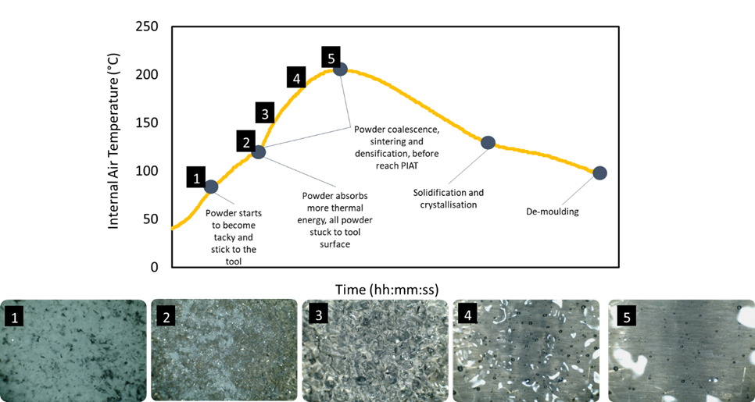

Slide 7
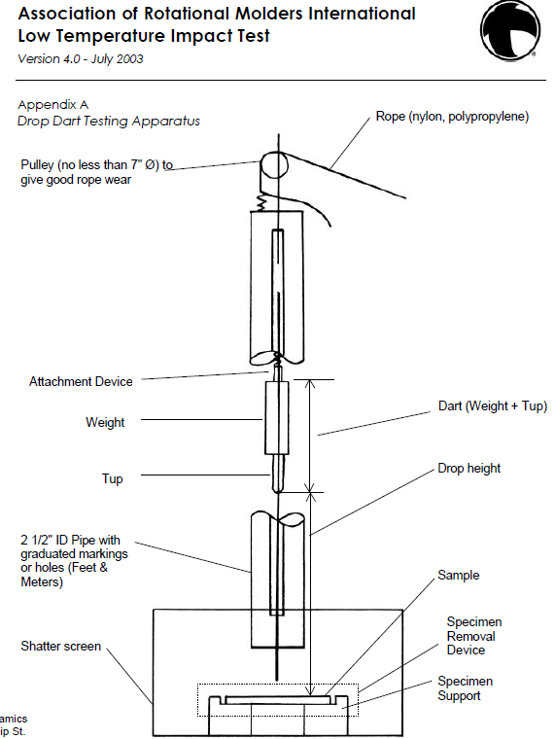
ARM Impact test
  Plaques conditioned at -40C
  Dart of 4.5 kg for 3 mm plaques
  Dart height is increased until failure
  Failure height and mode are recorded

Slide 8
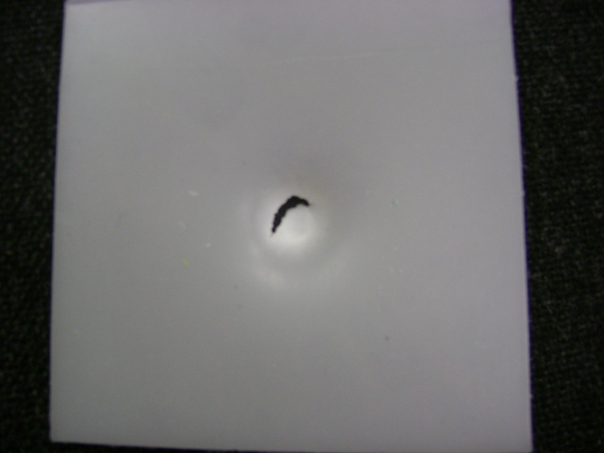
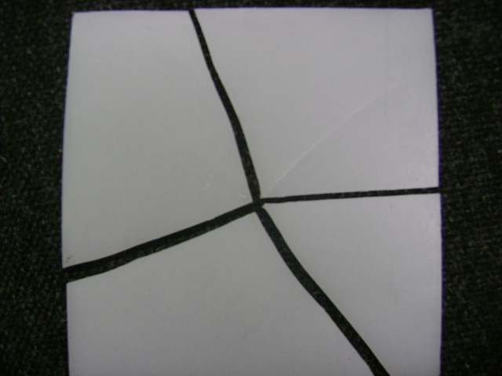
Ductile Vs Brittleness – Failure mode

Slide 9
Operating window
Operating window

Slide 10
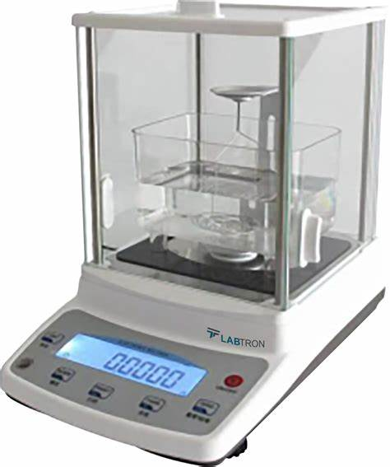
Part Density
  Plaques conditioned at room temperature
  Water bath
  Moulded part is weighed and then submerged into solution
  Very quick and easy method of understanding undercured material and high crystallinity

Slide 11
Part Density vs. Cycle Time

Slide 12
Part Density vs. Cycle Time
PINHOLES
PINHOLES-FREE

Slide 13
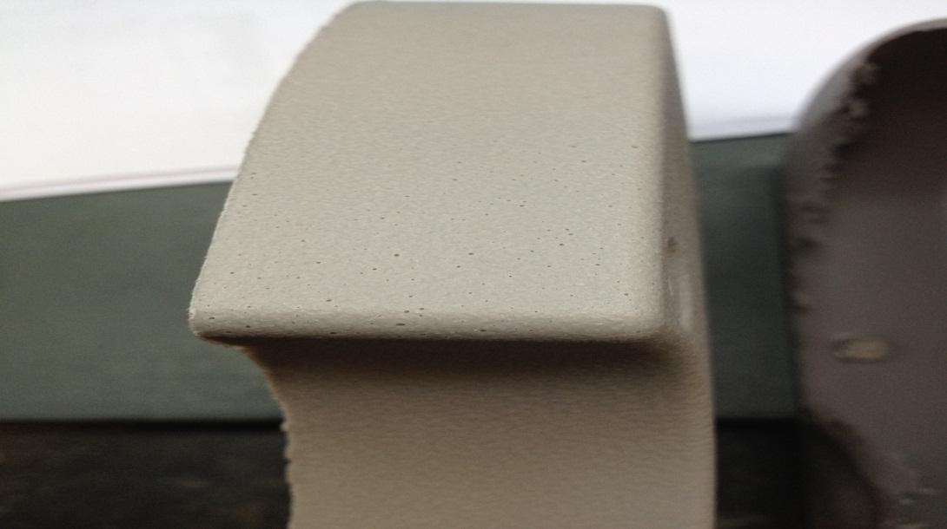
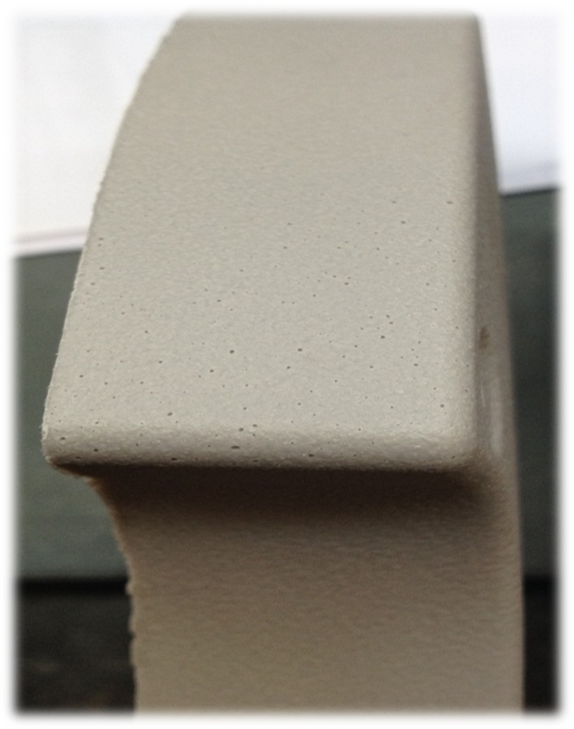
Surface Pinholes
Processing conditions
Rotomoulding Tool surface
Powder quality

Slide 14
Part Density vs. Cycle Time

Slide 15
Part Density vs. Cycle Time

Slide 16
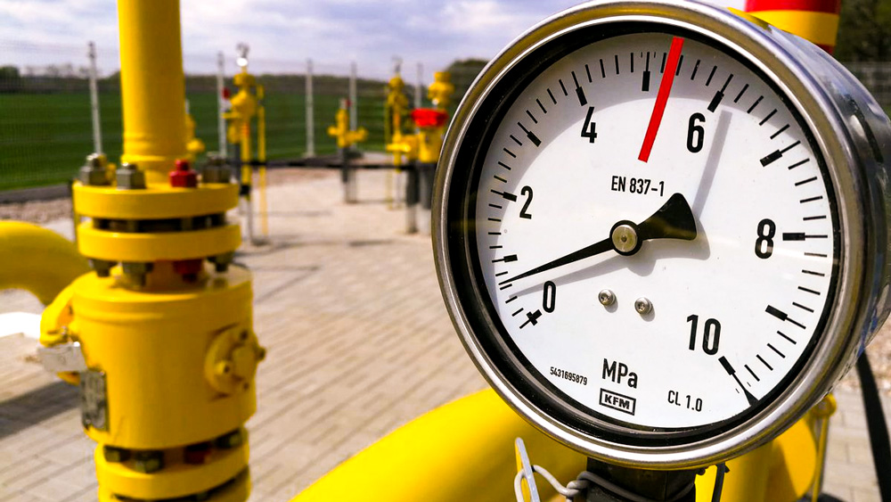
Gas Consumption – Part Density
PIAT (°C) | REVOLVE N-307 | EVOLVE N-307 | GAS (M³)
120 | - | - | 0,64
148 | 0,9276 | 0,9332 | 1,58
159 | 0,9271 | 0,9345 | 1,72
172 | 0,9286 | 0,9372 | 1,93
185 | 0,9361 | 0,9389 | 2,37
190 | 0,9370 | 0,9401 | 2,81
210 | 0,9392 | 0,9410 | 3,25
25% less gas at same part density

Slide 17
Energy Savings
Part Density vs. Oven Temperature

Slide 18
Energy Savings
Part Density vs. Oven Temperature
ΔT

Slide 19
Energy Savings
Part Density vs. Oven Temperature

Slide 20
Energy Savings
Part Density vs. Oven Temperature

Slide 21
Energy Savings
Part Density vs. Oven Temperature

Slide 22
ARM Impact Strength

Slide 23
ARM Impact Strength

Slide 24
ARM Impact Strength

Slide 25
Brittleness

Slide 26
Brittleness

Slide 27
Brittleness

Slide 28
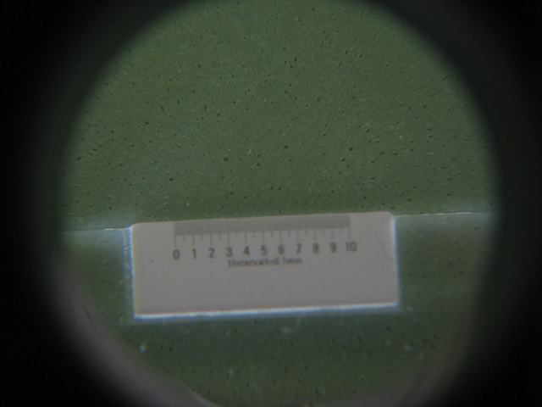
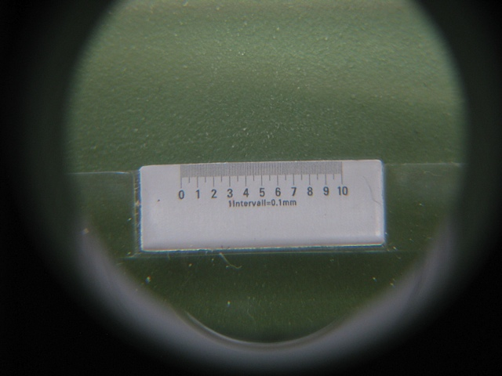
Surface Porosity Assessment
Standard Grade Evolve® Grade

Slide 29
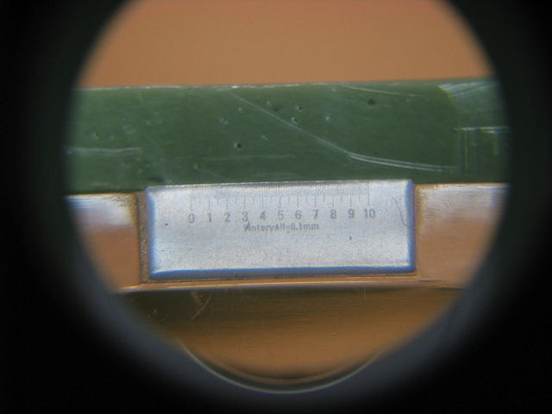
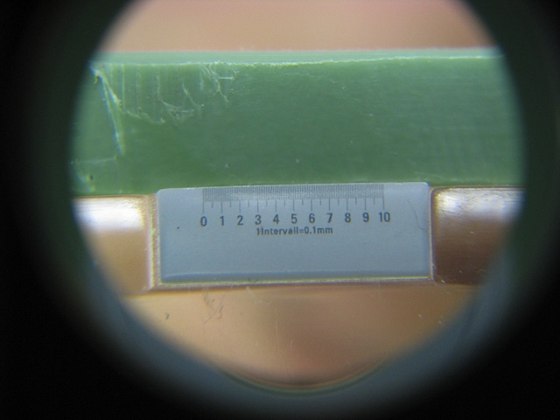
Cross-Section Assessment
Standard Grade Evolve® Grade

Slide 30
EVOLVE® - Benefits
  10-20% reduction in overall cycle time
  potentially increase production output
  Energy savings by 10-20% reduction in gas consumption
  Lower CO₂ emission
  Reduction in the number of pinholes, leading to improved part quality

Slide 31
Summary
Evolve® Technology can:
    Reduce cycle times​
    Increase productivity
    Reduce gas consumption​
    Reduce CO2 emissions
    Reduce Porosity/Pinholes
    Maintain material properties at lower energy input
    Be applied in the entire range of PE and PP grades by MATRIX POLYMERS

Slide 32



THANK YOU!
Dharana Jayawardane
Technical Manager
dharana.jayawardane@matrixpolymers.com
+ 44 7719 910 672
matrixpolymers.com

